Slide 1

Software Engineering Project
CLEAN FUEL RELIANCE PER COUNTRY
ITSC 3155
Group 3
Group members
Eshetu Wekjira
Colin O.Beirne
Irvin Victoria Ibanez
Seth Parsons
Sydney Melech

Slide 2
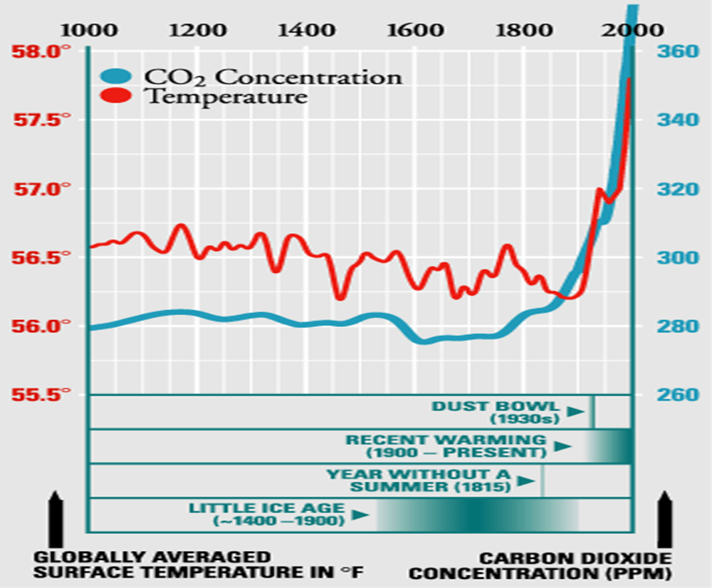
Product Overview The problem it addresses
There are environmental problems due to the expansion of industries.
Most industries or companies use fossil fuels which cause carbon emissions.

Slide 3
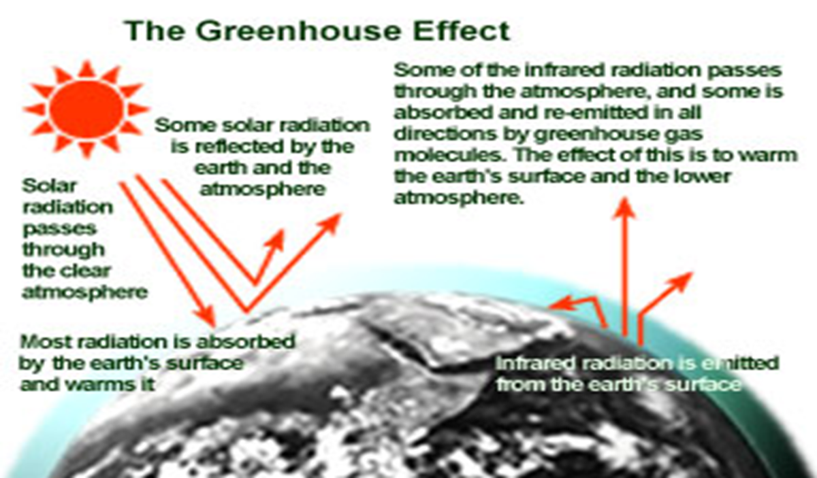
The problem it addresses continued
Fossil fuels pollute our environment, and it is not renewable, unsustainable, and dangerous during the drilling process.
Burning fossil fuels releases harmful particles and greenhouse gases into the atmosphere, resulting in adverse effects for humans and Earth.
The lack of resources countries have to improve their clean energy usage.

Slide 4
What are the benefits?
Conserving clean fuels reduces carbon emissions.
It helps to have a sustainable clean environment and reduce global greenhouse problems.
Reducing these emissions impacts local air quality, particularly in areas with a high density of flight movements, such as airports and some high manufacturing areas.
Improve air quality and efficient fuel.

Slide 5
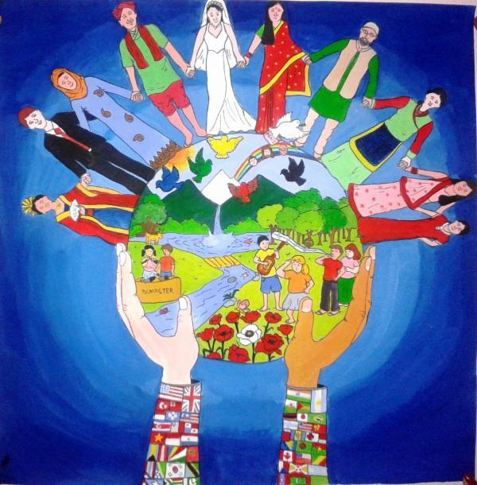
What are the benefits?
It helps to have a sustainable clean, harmony, peace environment
Improve life expectancy
Eradicating poverty

Slide 6
Solutions:
According to research, we are improving our environment's greenhouse problem by increasing the services of clean energy fuels across the country.
Replace fossil fuel with clean fuel and renewable energy.
Use a policy for a green legacy to overcome greenhouse emissions.

Slide 7
So What?
One of the global goals is to have a cleaner environment. Immunization brings newer, cleaner, and more sustainable technology to developing countries' health systems.
So, we related and combined our technology within an environment, tracked and visualized data, and quickly identified which countries have used more fossil fuels.

Slide 8
And would be to offer data analysis of the reliance on clean fuels of different countries so that other countries can see the impact of different solutions and determine where they should look.
This is needed because we need to stop using fossil fuels as our climate

Slide 9

Who is your audience?
Our audience is companies and individuals who do beneficiary work and are looking to invest in countries who lack the resources to improve their clean energy usage.

Slide 10

Demo
Walk through user stories by using scenarios

Slide 11
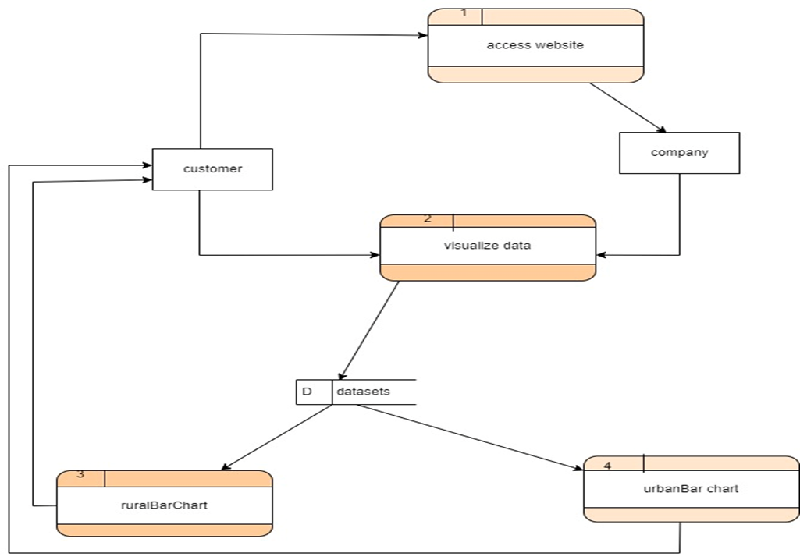
The System Model
DFD DIAGRAM

Slide 12
Customer/Partner Team Feedback
Had an easy to read presentation of data
The data was separated well into different regions
Accessing the data corresponding to the different regions was very easy to do
Overall layout of the website was nice

Slide 13
Major Challenges/Lessons learned
Time management
Role designation/Giving out tasks
Communication between teammates and other groups
Learned how to present data in a simple but effective way
Received feedback and had to make changes
Had to make sure our product was beneficial to any users

Slide 14
Thank you!!!!

